Slide 1
Non negotiables of Church Life Acts 2:42-47
Exalt
Evangelise
Encourage
Edify
Equip

Slide 2
Life in the Early Church
Challenges and Consequences
9 Jan - Kay Brown – Intro to Acts
16 Jan - Woody Baker – Peter & John
23 Jan - Ian Graham – Stephen
30 Jan - Sue de Pyle – Saul/Paul

Slide 4
Who wrote Acts
Acts 1:1-2 In my former book, Theophilus, I wrote about all that Jesus began to do and to teach until the day he was taken up to heaven, after giving instructions through the Holy Spirit to the apostles he had chosen.
Luke- medical doctor, historian, eye witness, Gentile

Slide 5
Facts on Acts
The Church grew from handful of believers Acts 1:11 to Asia Minor, Eastern Europe and to Rome in 30 years
Holy Spirit mentioned over 50 times
Work of the Holy Spirit in every chapter
Word witness/testify/tell used more than 30 times

Slide 6
BUT YOU WILL RECEIVE POWER WHEN THE HOLY SPIRIT COMES ON YOU

Slide 8
Witnessing in Acts
Acts 1 – 12 Peter witnesses to the Jews
Repent Acts 2:36-38
Acts 13-28 Paul witnesses to the Gentiles
Believe Acts 16:30-31

Slide 9
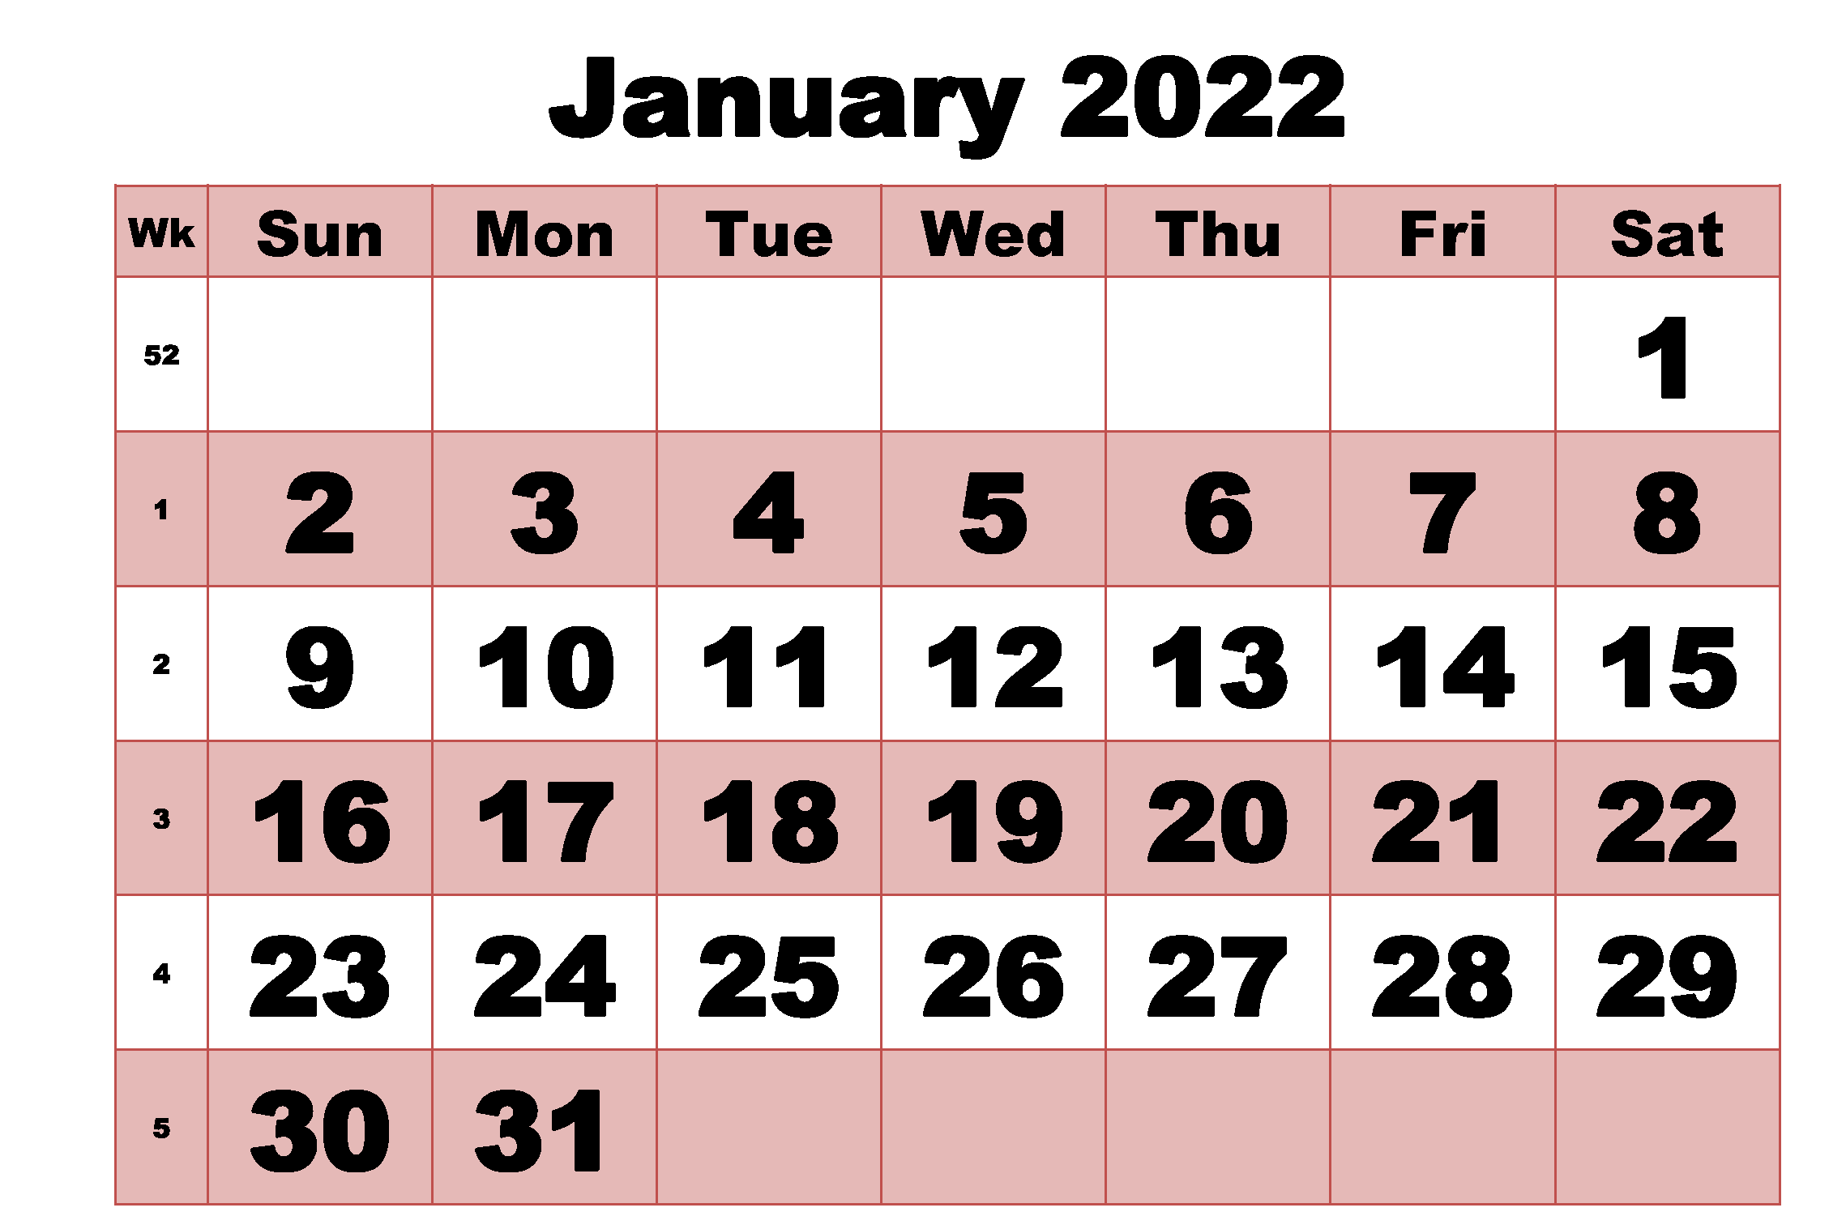
Read the book of Acts

Slide 10
We aim to be
- spiritually vibrant - evangelistically effective - community impacting - multi-generational - multi-ethnic - multiplying disciples

